Slide 1

Analysis of Budapest Neighborhoods
By
Sethumadhavan Aravindakshan

Slide 2
INTRODUCTION

Slide 3
Objective
Our aim is to aid anyone who visits Budapest city for either Employment, Business or Tourism in deciding the place of stay based on what each neighborhood has to offer, and their personal preferences
To obtain that results, First the neighborhoods have to be grouped as follows :
Fully developed neighborhood
Moderately developed neighborhood
Developing neighborhood
Underdeveloped neighborhood

Slide 4
Data Sources
List of all districts and postal codes of Budapest city
Geographical co-ordinates of each neighborhood is extracted using the Geocoder from Geopy python library.
Venue data from Foursquare API

Slide 5
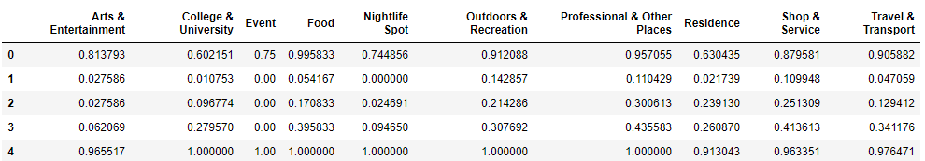
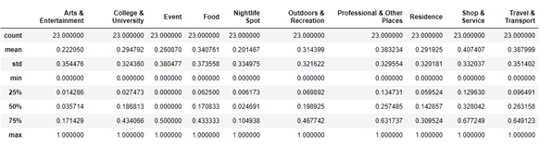
Data Preparation and EDA
Data Preparation :
Data Normalization – Min Max scaler
EDA :
Descriptive statistics -

Slide 6
Modelling

Slide 7
Model Building
Unsupervised Machine Learning
Clustering Technique
K-means clustering

Slide 8
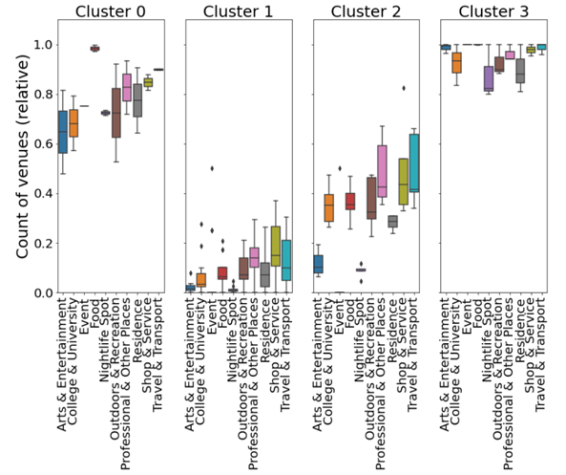
Clusters

Slide 9
Results

Slide 10
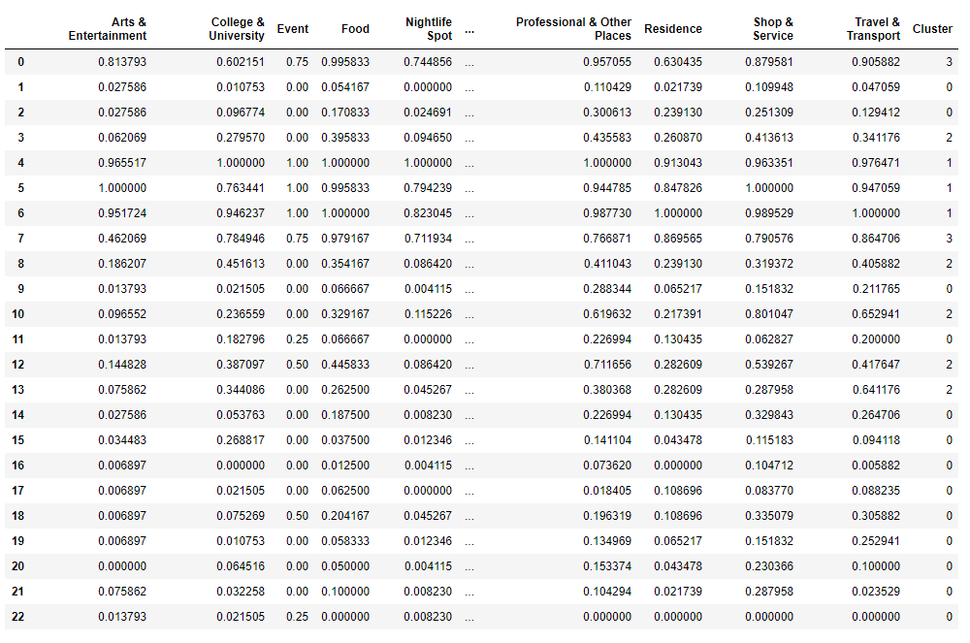

Slide 11
Interpretting results
The obtained clusters can be interpreted and visualized on the map as below:
Cluster 0 (Blue) - is the moderately developed districts of the city.
Cluster 1 (Green) - has low frequencies for all venue categories. They appear to be underdeveloped neighborhoods of the city.
Cluster 2 (Red) - has average scores with more professional places and Transport services being the most popular hence falling under the developing neighborhoods bucket. These are mostly residential suburbs.
Cluster 3 (Pink) - has consistently high frequencies for all venue categories. This is the most diversely developed part of city.

Slide 12
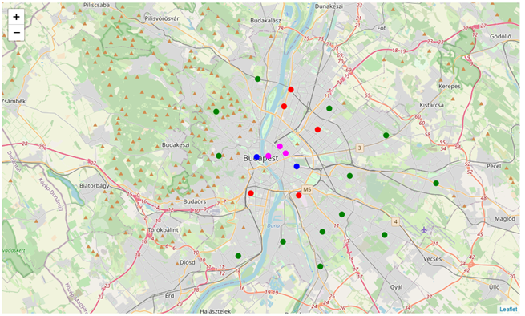
Cluster Markers added to the Budapest Map

Slide 13
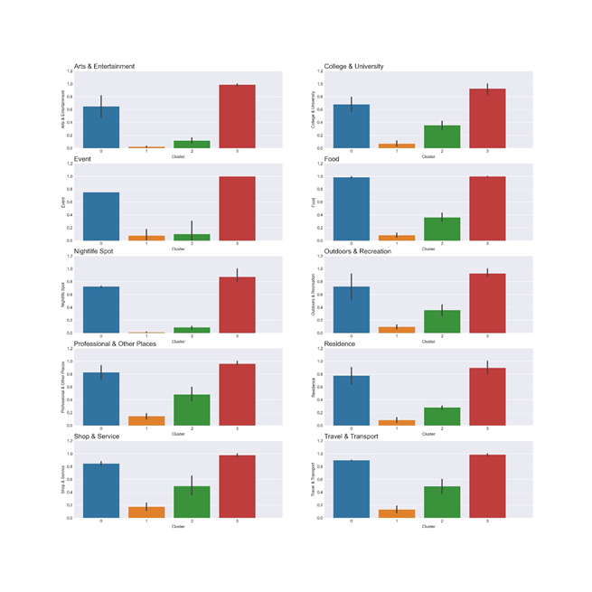
Cluster wise frequencies for each category

Slide 14
Discussions

Slide 15
Additional Key Findings
As per our analysis we can see that few neighborhoods of Budapest city can be classified as fully developed, moderately developed, developing and underdeveloped Neighborhoods based on the data from Foursquare API. But with Budapest city as one of the fast-growing tech hubs of Eastern Europe, we can expect the urban footprint of the Budapest city will expand as new growth areas keeps establishing every year.
As per our analysis we can see that few neighborhoods of Budapest city can be classified as fully developed, moderately developed, developing and underdeveloped Neighborhoods based on the data from Foursquare API. But with Budapest city as one of the fast-growing tech hubs of Eastern Europe, we can expect the urban footprint of the Budapest city will expand as new growth areas keeps establishing every year.
Districts IV, IX, XI, XIII & XIV emerge as the major growing areas and might even see a transformation from Developing neighborhood to downtown/ uptown as its land usage and the number of tech companies in these districts is increasing in last few years.

Slide 16
Future scope
It would be interesting to further study how we need to consider rental prices and the population data to Predict a growth pattern in these neighborhoods which will also lead us to identify early business and service opportunities in currently underdeveloped areas.

Slide 17
Conclusion
Our aim is to aid anyone who visits Budapest city for either Employment, Business or Tourism in deciding the place of stay based on what each neighborhood has to offer, and their personal preferences and our analysis was able to successfully serve the purpose.

Slide 18
Thank You!!!

